Slide 1
Sequence Diagrams
Programming – Code Design & Data Structures

Slide 2
Contents
What is a Sequence Diagram
Objects and Lifelines
Messages
Alternatives, Options and Loops
Tips

Slide 3
What is a Sequence Diagram
Shows the interaction between objects in the sequential order those interactions occur in
Each diagram describe a use case
An action, event or interaction performed by a user
It defines the event sequences that result in some desired outcome

Slide 4
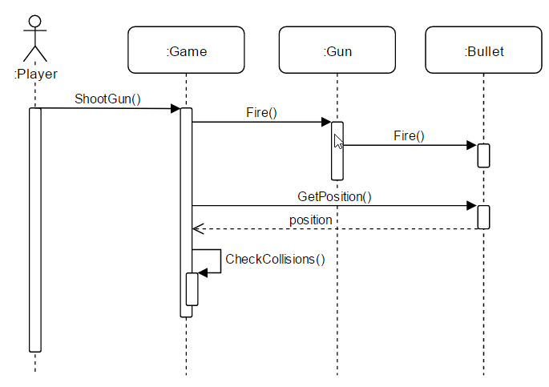
Sequence Diagram
This diagram models the player shooting a gun
Arrows represent the messages sent between objects
In the context of a program, these are function calls
When describing a networked game, these might actually be real messages

Slide 5
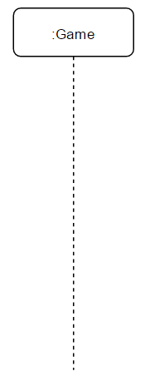
Objects and Lifelines
Objects are shown as boxes at the top of a dashed vertical line
This vertical line is called the object’s lifeline
The lifeline represents the object’s life during the sequence interaction
If the object exists for the whole interaction, then the line must continue to the bottom of the diagram
The format for naming objects is: [Instance Name] : Class Name
The instance name is optional

Slide 6
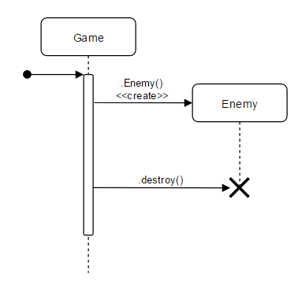
Objects and Lifelines
When an object is created in response to a message, the lifeline begins at that message
If an object is destroyed, the lifeline ends
A cross is placed at the point where the lifeline ends
The example here is contrived to demonstrate the syntax

Slide 7
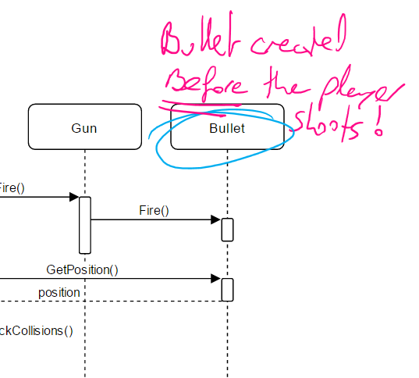
But…
Looking closely at the Shoot Bullet example, we see the Bullet exists before it was fired
This would be the case if we are using an Object Pool to recycle our objects
Object Pools are discussed in a future session
The point is, the way your diagram is drawn will denote design and implementation choices
The details are important!

Slide 8
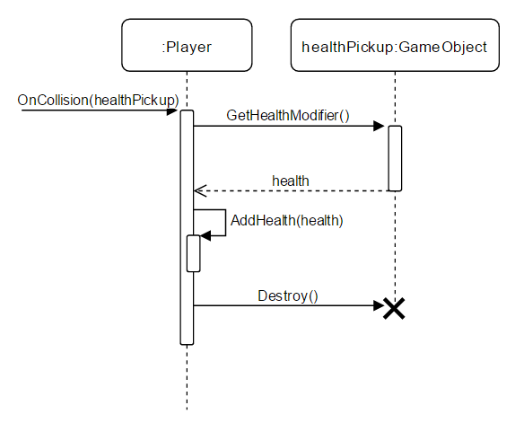
Messages
The first message starts at the top
And usually on the left, for readability
Messages are drawn as a line with a solid arrowhead to the receiving object
The message or method name is placed above the line
The message that is being sent represents the function that the receiving object’s class implements

Slide 9
Messages
You can also show return messages
These are the values that are returned as a result of calling a function
A return message is shown as a dotted line, with an open arrowhead
Your return message will always go back to the sender of the original message
Adding return messages is optional, and depends on the level of detail you want to include

Slide 10
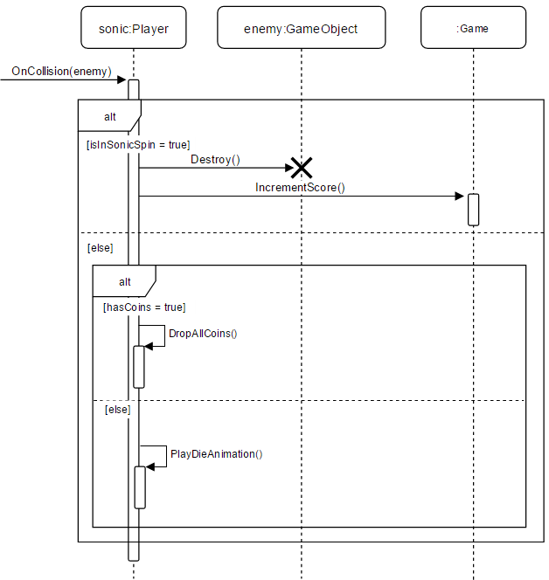
Alternatives
Designate a mutually exclusive choice between two or more message sequences
The word ‘alt’ is placed in the frame’s namebox
The condition is placed within a guard [ ]
[isInSonicSpin = true]
The example shows an abstraction of Sonic colliding with an enemy

Slide 11
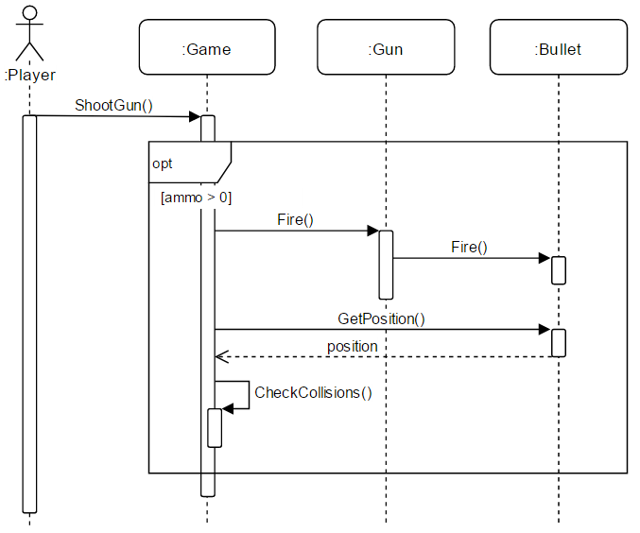
Option
Similar to the alternative
The word ‘opt’ is placed in the frame’s namebox
The condition that must be met is placed in the guard [ ]
The condition guard is optional

Slide 12
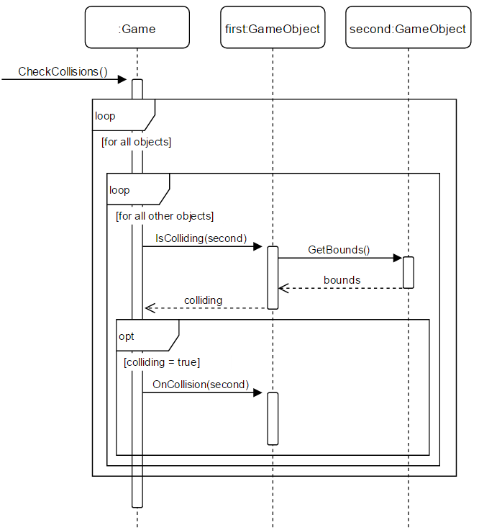
Loops
Loops are similar to the Option
The word ‘loop’ is placed in the frame’s name box
The condition that must be met is placed in the guard [ ]
The condition guard is optional

Slide 13
Tips
Don’t try to model your whole game (or the update loop) in the one sequence diagram
Sequence diagrams work best when you limit their scope to a single event
Try to model player use cases
For example, what happens when the player shoots?; what happens when Sonic jumps on an enemy?; what happens when Mario goes down a pipe?

Slide 14
Summary
Sequence diagrams show the interaction between objects in your game
You can think of them as showing ‘what operations are called on which objects in response to this event’
You can show as much (or as little) detail as you choose in your Sequence diagram
They are useful at multiple levels of abstraction
You can add detail like alternatives, optional message sequences and loops to your diagrams

Slide 15
Further Reading
IBM Developer Works. 2017. UML basics: The sequence diagram. [ONLINE] Available at: https://www.ibm.com/developerworks/rational/library/3101.html. [Accessed 12 April 2017]
Lorenzo Phillips, 2002. Game Programming Tricks of the Trade (Premier Press Game Development). 1 Edition. Muska & Lipman/Premier-Trade.

